Slide 1

REINFORCEMENT PROJECT COVID ANALYSIS
Anupriya.C
Data Analytics And Data Science

Slide 2
PROJECT OVERVIEW
Downloaded From Mockagroo
Generated the Data Set
Created Few Charts and Calculated Fields
Created Meaningful Dashboards
Created Story to know about the insights

Slide 3
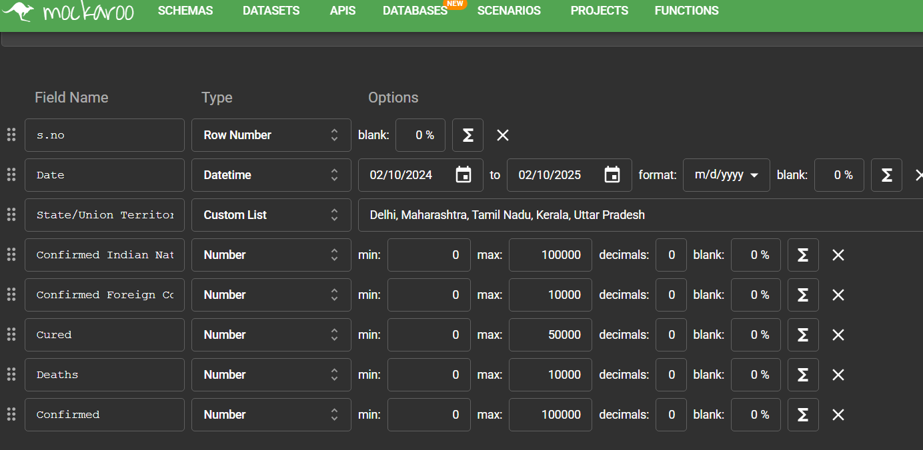
GENERATED DATA SET

Slide 4
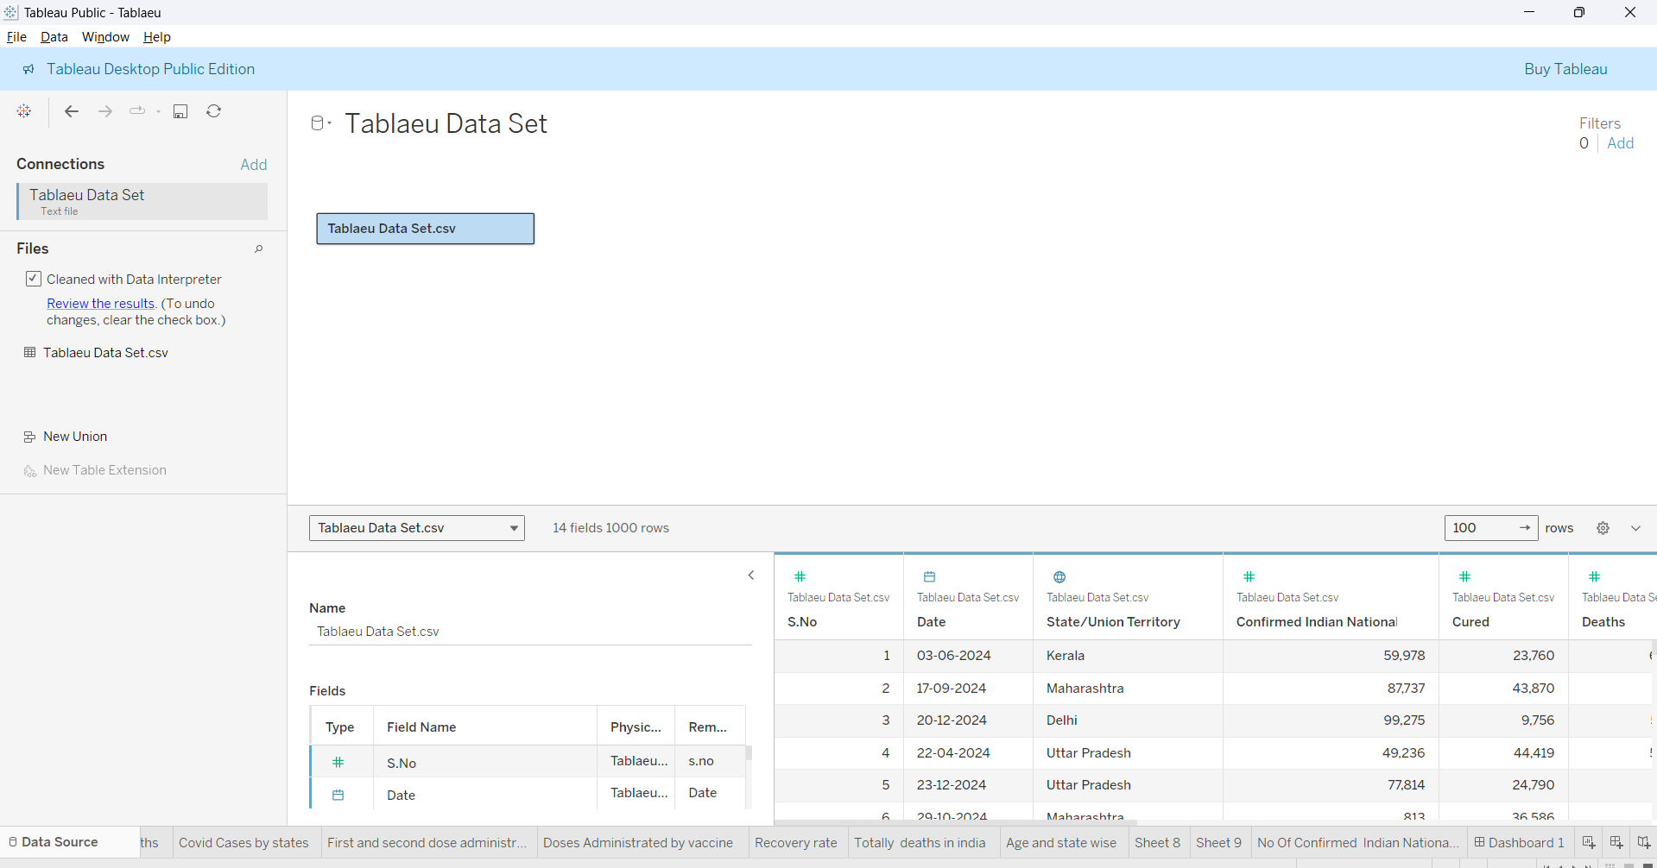
DATA SOURCE

Slide 5
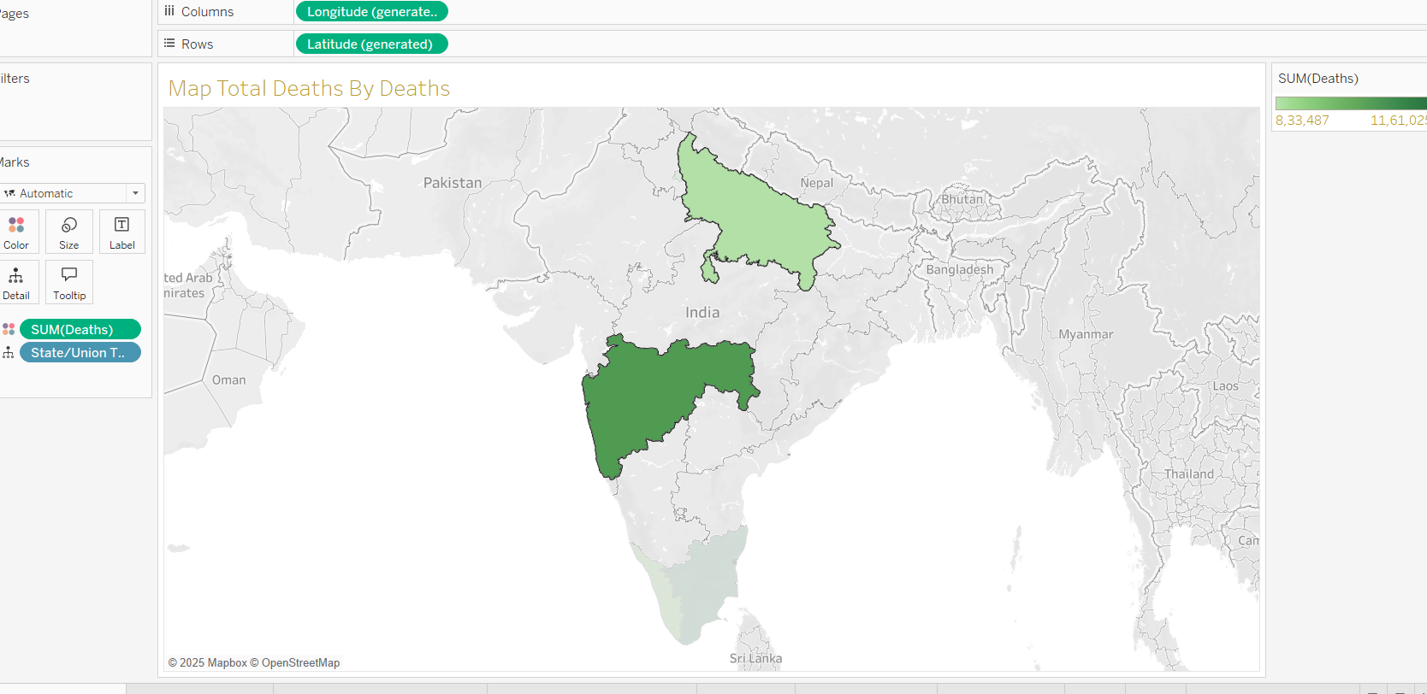
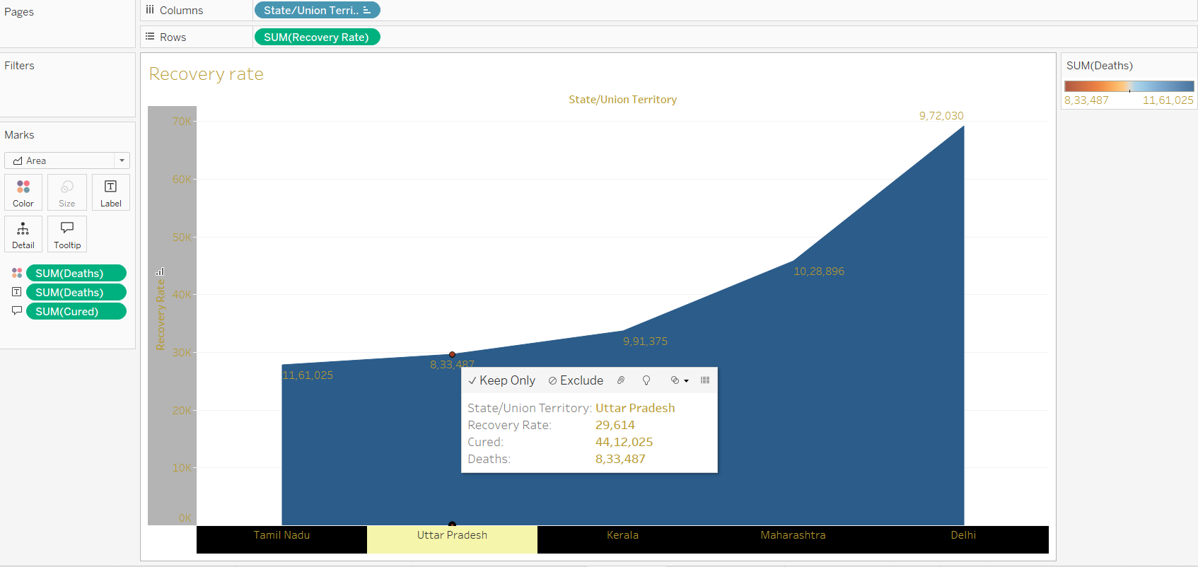
VISUALIZATION

Slide 6
DIFFERENT VISUALS
Total Covid Confirmed
Total Vaccinated state Wise
Total Got Cured in India
Total Recoveries
Total Deaths in India
Age and State wise
No OF Indian Nationality Confirmed

Slide 7
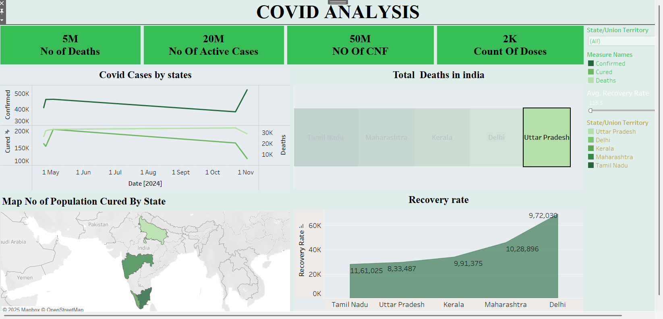
Dash Board

Slide 8
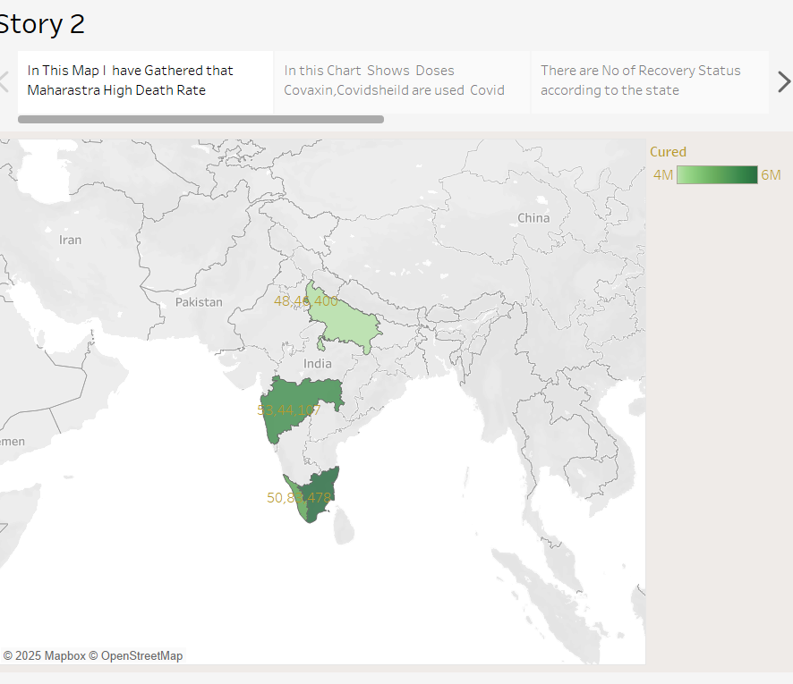
Story

Slide 9
Insights Recommendations
No Of active cases
No Of Deaths
Uttar Pradesh appears to be hotspot with a number of Deaths.
Monitor and apply best practices from these states to improve recovery in others.
Provide rehabilitation programs for long-COVID patients.
20M
No of Confimed
50M
20M
5M

Slide 10
Thank you

